Slide 1


Tracking Multiple Objects
Tom Zimmerman
IBM Research-Almaden
Sept 23, 2020
This material is based upon work supported by the NSF under Grant No. DBI-1548297.
Disclaimer: Any opinions, findings and conclusions or recommendations expressed in this material are those of the authors and do not necessarily reflect the views of the National Science Foundation.

Slide 2
Adding to Feature Vector to Feature Array
Call getFeature that returns 1 x N (two dimensional) featureVector.
1 x 4 vector
featureVector
Routine calling getFunction appends featureVector (1xN) to featureArray (MxN).
3 x 4 array
It can be added to a M x N array
featureArray
before getFeature call
4 x 4 array
Resulting in a featureArray with one new row on the bottom (M+1 x N).
To create a
(M+1) x N array
using np.append()
featureArray
after getFeature call
Create featureArray
featureArray=np.empty((0,MAX_FEATURES), dtype='float’) # creates a 2D array with zero rows
Saving featureArray
header='frameCount,objID,area,ar,solidity,texture’ # a text string used as the first row of csv output
np.savetxt(featureFileName,featureArray,header=header,fmt='%f',delimiter=',’) # save numpy array as csv

Slide 3
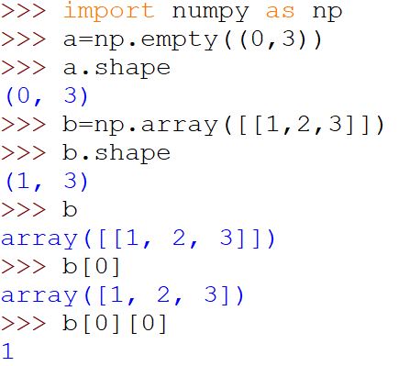
Numpy Two-Dimensional Array Creation and Indexing
1
2
3
4
5
6
7
8
9
10
11
12
13
........... Import numpy into shell
........... Create empty 2D array
........... Get shape of array “a”
..... Create 2D array with first row of values
..... Display shape of array “b”
...... Display value of entire array “b” (only 1 row)
..... Display first row
..... Display first column of first row

Slide 4
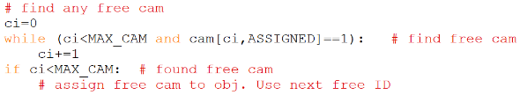
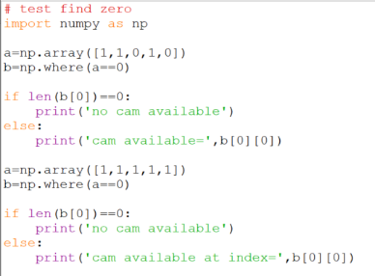
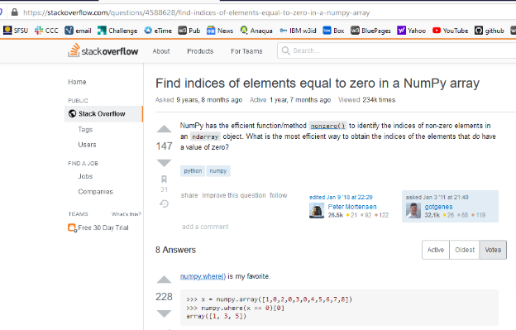

Finding Location of Value in Array
1. Find cam that is unassigned, i.e. index where cam[index,ASSIGNED]==0
4. Write test code
2. Is there a better way, i.e. easier to understand, more compact code?
3. Search “python find next zero in array”
>> cam available= 2
>> no cam available
5. Write better way into program

Slide 5
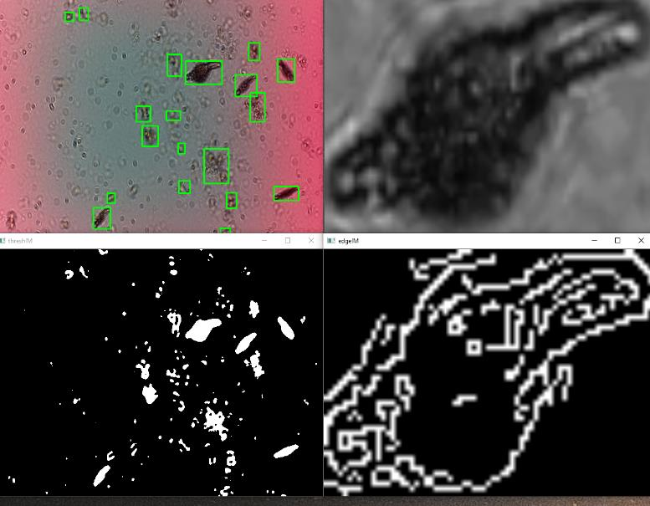
Detect & Shape Feature
frame 1 obj 1 area 504 ar 3.1
frame 1 obj 2 area 256 ar 1.1
frame 1 obj 3 area 111 ar 1.0
frame 1 obj 4 area 595 ar 3.2
frame 2 obj 1 area 156 ar 1.4
frame 2 obj 2 area 516 ar 3.1
frame 2 obj 3 area 260 ar 1.0
frame 2 obj 4 area 117 ar 1.1
frame 3 obj 1 area 150 ar 1.4
frame 3 obj 2 area 513 ar 3.2
frame 3 obj 3 area 110 ar 1.1
frame 3 obj 4 area 337 ar 1.7
Gray ROI
Canny Edge

Slide 6
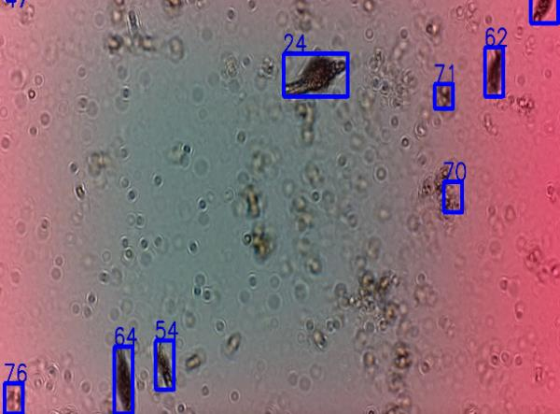
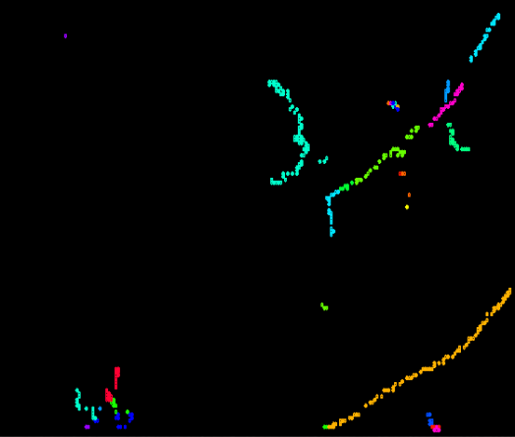
Tracking Multiple Objects
Tracket: A temporal sequence of a single object positions across frame boundaries
Tracklets
6
1
5
4
3
2

Slide 7
Coding Approach to Tracking Multiple Objects
Object Feature Vector:
Created every frame
Obj number assigned in image scan order (start bottom right)
Contains bounding box coordinates and shape features
Cam Vector:
Persists and maintains ID across frame.
One object assigned to one cam
Inactive cam assigned to free object and becomes active.
Active cam becomes inactive when no object near.
Contains bounding box coordinates, shape and dynamic features
Used to creates tracklets

Slide 8
Cam Model of Tracking Objects
“cam” is like a camera that tracks position of object
cam vector keeps track of object position, features and unique identification
Constants
MAX_CAM number of cams
MAX_DIST max distance a cam can move in a frame
MAX_DELTA_AREA max change in area of an object in a frame
Variables
nextID next ID to be assigned
ci index to cam array
oi index to obj array
Arrays
obj[:,:] obj vector (location, features, flags)
cam[:,:] cam vector (location, features, ID, flags)
cam[ci,ASSIGNED] flag indicating cam is assigned to obj
cam[ci,ACTIVE] flag indicating cam is tracking obj
obj[oi,ASSIGNED] flag indicating obj is assigned to cam
object
cam
frame

Slide 9
Initial Conditions
cam[:,ASSIGNED]=0
obj[:,ASSIGNED]=0
cam[:,ACTIVE]=0
MAX_CAM=20 # number of cams
MAX_DIST= * # max distance an object can move in a frame
MAX_DELTA_AREA= * # max change in object area in a frame
* Must determine empirically by running program and (a) print out and observe reasonable values, (b) plot and observe a histogram or (c) perform a statistical analysis and take the first standard deviation.
nextID=1

Slide 10
First Frame
Assign cam to obj
cam[ci,ASSIGNED]=1 #Set flag indicating cam is assigned
obj[oi,ASSIGNED]=1 #Set flag indicating obj is assigned
cam[ci,ACTIVE]=1 #Set flag indicating cam is active
Assign nextID to assigned cam
cam[ci,ID]=nextID
nextID+=1 # Increment nextID each time cam assigned
1
2
3
nextID=4

Slide 11
Next Frames
1
2
Obj moved since last frame
3
NextID=4
TRACK ASSIGNED CAM
Move active cam to nearest obj
Don’t move if distance too big
Don’t move if change in area too big
Update cam assigned and active flags
ASSIGN NEW OBJ
Assign any left over obj to any unassigned cam
Increment NextID when new ID assigned
Update cam assigned and active flags
INACTIVATE CAM WITHOUT OBJ
Make inactive any active cam that is not assigned
1
2
3
NextID=4

Slide 12
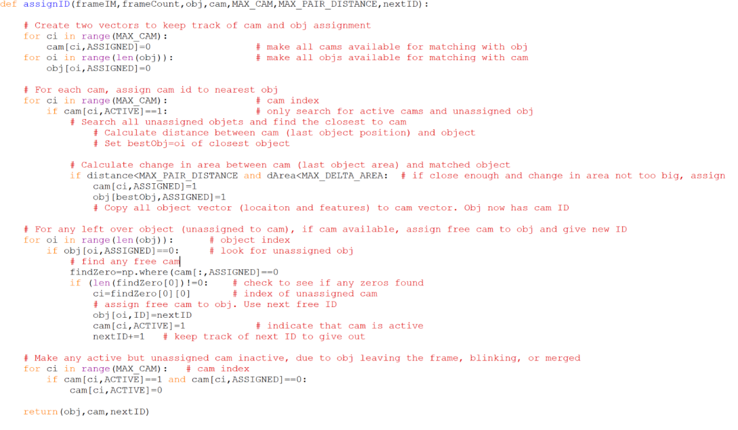
Tracking Multiple Objects: Code Outline using Cams
1
2
3
4
5
6
7
8
9
10
11
12
13
14
15
16
17
18
19
20
21
22
23
24
25
26
27
28
29
30
31
32
33
34
35
36
37

Slide 13
Tracking Challenges
Merge Split Blink

Slide 14
Homework #6 Assignment: Tracking
Assigned: 23 Sept 2020
Due: 29 Sept 2020 3 PM
READING ASSIGNMENTS
For EACH reading assignment, write three things you learned. Upload report as PDF document
1. "Global and Local Variables in Python" https://www.geeksforgeeks.org/global-local-variables-python/?ref=lbp
2. "Looping Techniques in Python" https://www.geeksforgeeks.org/looping-techniques-python/?ref=lbp
3. "Numpy Array Creation" https://www.geeksforgeeks.org/numpy-array-creation/?ref=lbp
4. "Numpy Indexing" https://www.geeksforgeeks.org/numpy-indexing/?ref=lbp
5. "Using 2D arrays/lists the right way" https://www.geeksforgeeks.org/python-using-2d-arrays-lists-the-right-way/
CODING ASSIGNMENTS
For EACH coding assignment, upload your working code (track.py) and csv output (trackOutput.csv)
1. Modify your Feature code (Homework #5) so it saves a csv file of the features for the entire movie in the following format (your feature list may be different)...
FRAME,ID,X0,Y0,X1,Y1,XC,YC,AREA,AR,SOLIDITY,TEXTURE
1,0,406,306,451,365,427,334,1252,14,.80,0.12
1,1,282,261,313,301,294,279,751,10,0.49,0.21
2. Complete the assignID function reviewed in class, call it from your "Coding Task 1" program (above), and use the ID assigned by the cam in the csv file.
3. Run Coding Task #2 and determine the best values for MAX_PAIR_DISTANCE and MAX_DELTA_AREA. Upload the code (bestDistanceArea.py) you used to determine values and put the values at the top of the program as a comment.

